Slide 1

Wi-Fi Jamming
Understanding Wireless Networks and Preventing Disruptions in Modern Computing Environments

Slide 2

Understanding Wi-Fi Networks
What is Wi-Fi?
Wi-Fi is a wireless networking technology that allows devices to communicate over radio waves without physical cables. It's based on IEEE 802.11 standards and has become the backbone of modern connectivity.
The technology operates through a client-server model where access points broadcast signals that client devices receive and respond to.
Basic Architecture
Access Point (AP): The central hub that broadcasts the wireless signal and manages connections
Client Devices: Laptops, phones, and IoT devices that connect to the AP
Protocol: 802.11 standard governs how data packets are formatted and transmitted

Slide 3




Wi-Fi Communication Basics
Frequency Channels
Modulation
2.4 GHz: Longer range, more interference
Data is encoded onto radio waves using techniques like OFDM (Orthogonal Frequency Division Multiplexing) to maximize throughput and minimize errors.
5 GHz: Faster speeds, shorter range
6 GHz: Newest standard with minimal congestion
Signal Quality
Signal Strength: Power of the transmission
SNR: Signal-to-Noise Ratio determines connection quality and speed
Wi-Fi is inherently vulnerable to interference because it operates on shared, unlicensed spectrum that anyone can use. Multiple devices competing for the same airspace create challenges for reliable communication.
Notes:
3

Slide 4
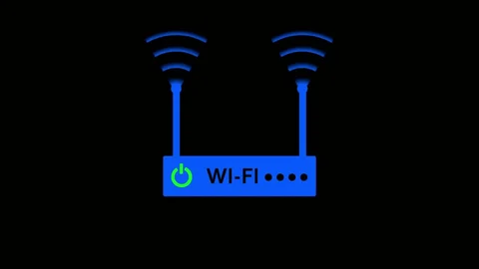
Understanding Wireless Interference
1
Natural Interference Sources
Microwave ovens operating at 2.4 GHz
Bluetooth devices sharing spectrum
Physical barriers like walls and metal
Cordless phones and baby monitors
2
Device Congestion
Too many devices connecting to a single access point create bandwidth competition. Each device must wait its turn to transmit, slowing the entire network.
3
Spectrum Overlap
Neighboring networks on the same or adjacent channels interfere with each other. The 2.4 GHz band only has 3 non-overlapping channels, making congestion common in dense areas.
4
Accidental Signal Flooding
Misconfigured devices or malfunctioning equipment can unintentionally broadcast excessive traffic, degrading network performance for everyone nearby.
All examples above represent legal, naturally occurring interference—not intentional jamming or malicious attacks.
Notes:
4

Slide 5
Unauthorized Attacks:-
⚠️ The following information is presented for educational awareness only. Implementing these techniques without authorization is illegal and unethical.
Packet Injection
Deauthentication Attacks
Rogue Access Points
Attackers can insert malicious data packets into network traffic, potentially causing disruptions or security breaches. This requires specialized hardware and software.
Unauthorized APs that mimic legitimate networks to intercept traffic or steal credentials. Users unknowingly connect, exposing sensitive data.
Exploiting management frames in the 802.11 protocol to forcibly disconnect legitimate users from networks. Modern WPA3 provides some protection against this.
Real-World Consequences: These attacks are federal crimes under telecommunications regulations. Perpetrators face significant fines, criminal prosecution, and imprisonment. They also cause serious harm to businesses, institutions, and individuals who depend on reliable connectivity.
Notes:
5

Slide 6

Laws, Ethics & Responsible Research
Legal Framework
Wireless jamming and unauthorized network interference are illegal under federal telecommunications law in the United States and most countries worldwide.
FCC regulations prohibit intentional interference
Computer Fraud and Abuse Act (CFAA) protects networks
Wiretap Act governs interception of communications
State laws add additional penalties
Authorized Testing Only
Security research must be conducted only on networks you own or with explicit written permission from the network administrator. Educational labs should use isolated environments.
Ethical Hacking Principles
Responsible researchers follow strict ethical guidelines: obtain permission, minimize harm, respect privacy, disclose vulnerabilities responsibly, and never misuse discovered information.
Notes:
6

Slide 7
What is Kali Linux?
Purpose-Built OS
Professional Toolkit
Educational Platform
Kali Linux is a Debian-based Linux distribution specifically designed for digital forensics, penetration testing, and security auditing. It comes pre-installed with hundreds of security tools.
Includes industry-standard tools for network analysis, vulnerability scanning, password testing, wireless security assessment, and forensic investigation—all in one platform.
Widely used in cybersecurity courses, certification training (CEH, OSCP), and academic research. Provides hands-on experience with real security tools in controlled environments.
Important: Kali Linux is powerful software that should only be used for legitimate security research, authorized testing, and educational purposes. Misuse can have serious legal consequences.
Notes:
7

Slide 8
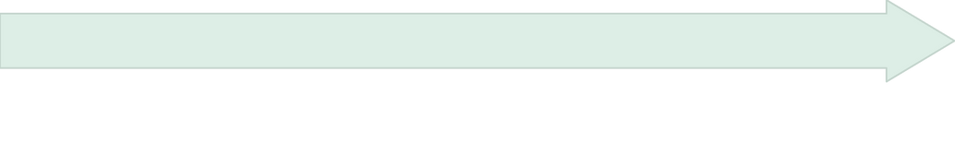
Installing Kali Linux in VirtualBox
Get Kali Linux Image
Download VirtualBox
Navigate to kali.org/get-kali and download the VirtualBox image (pre-built .ova file) or ISO installer. The pre-built image is recommended for beginners.
Visit virtualbox.org and download the appropriate version for your operating system (Windows, Mac, or Linux). Install with default settings.
Start & Configure
Import into VirtualBox
Launch the VM, log in with default credentials (username: kali, password: kali), and update the system using sudo apt update && sudo apt upgrade in the terminal.
Open VirtualBox, click "Import," select the downloaded .ova file, and adjust settings (allocate at least 2GB RAM and 20GB disk space). Click "Import" to complete.
Virtual machines provide a safe, isolated environment for security research without affecting your main operating system or network.
Notes:
8

Slide 9
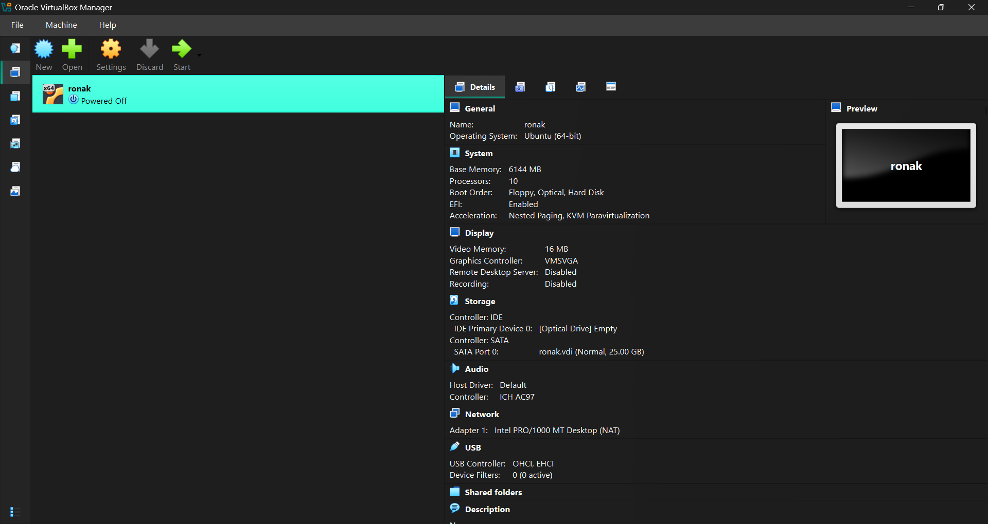


Slide 10
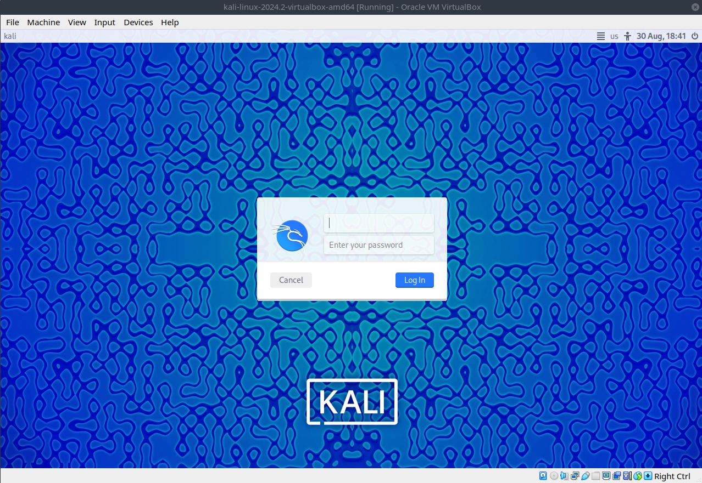

Slide 11
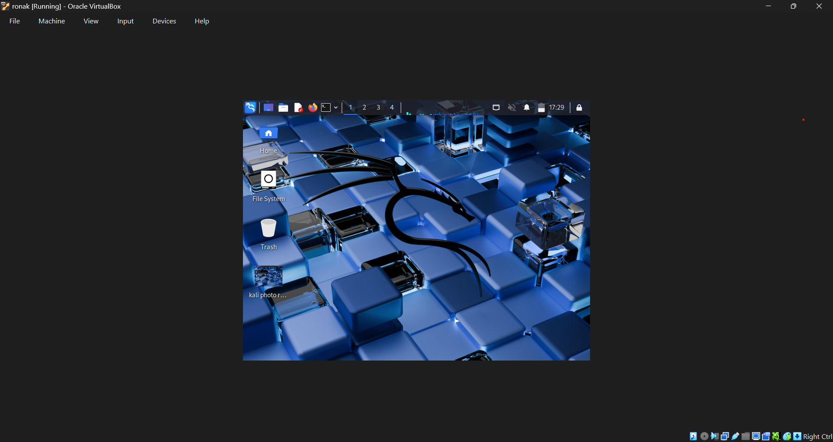


Slide 12
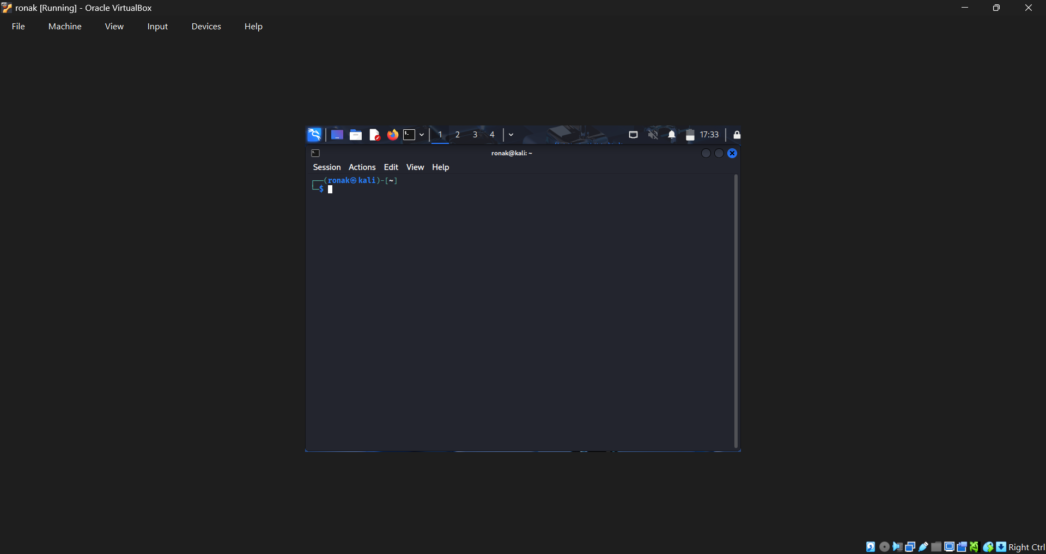

Slide 13
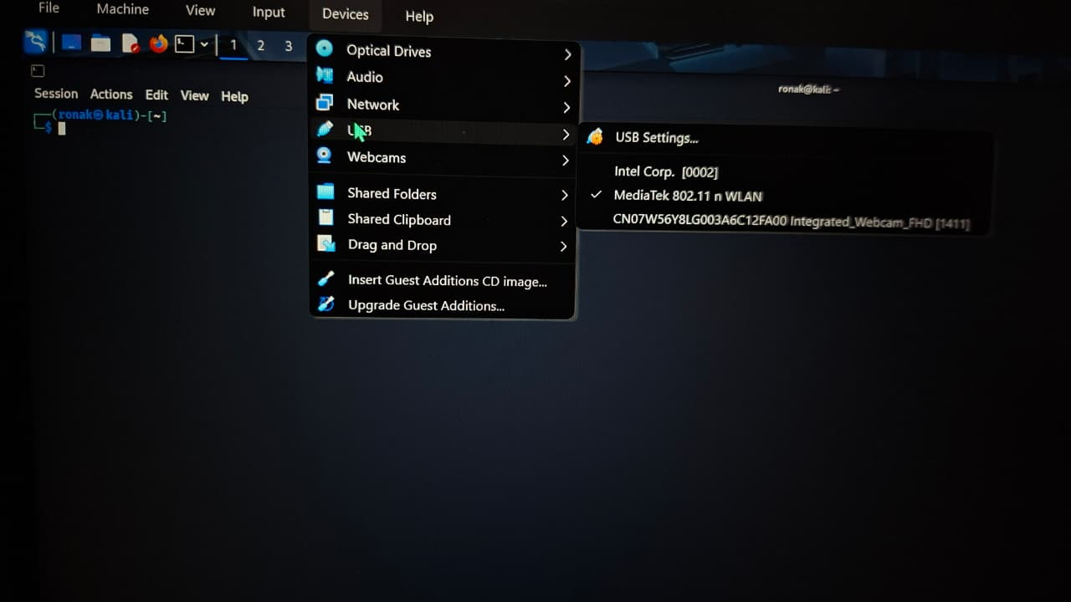

Slide 14
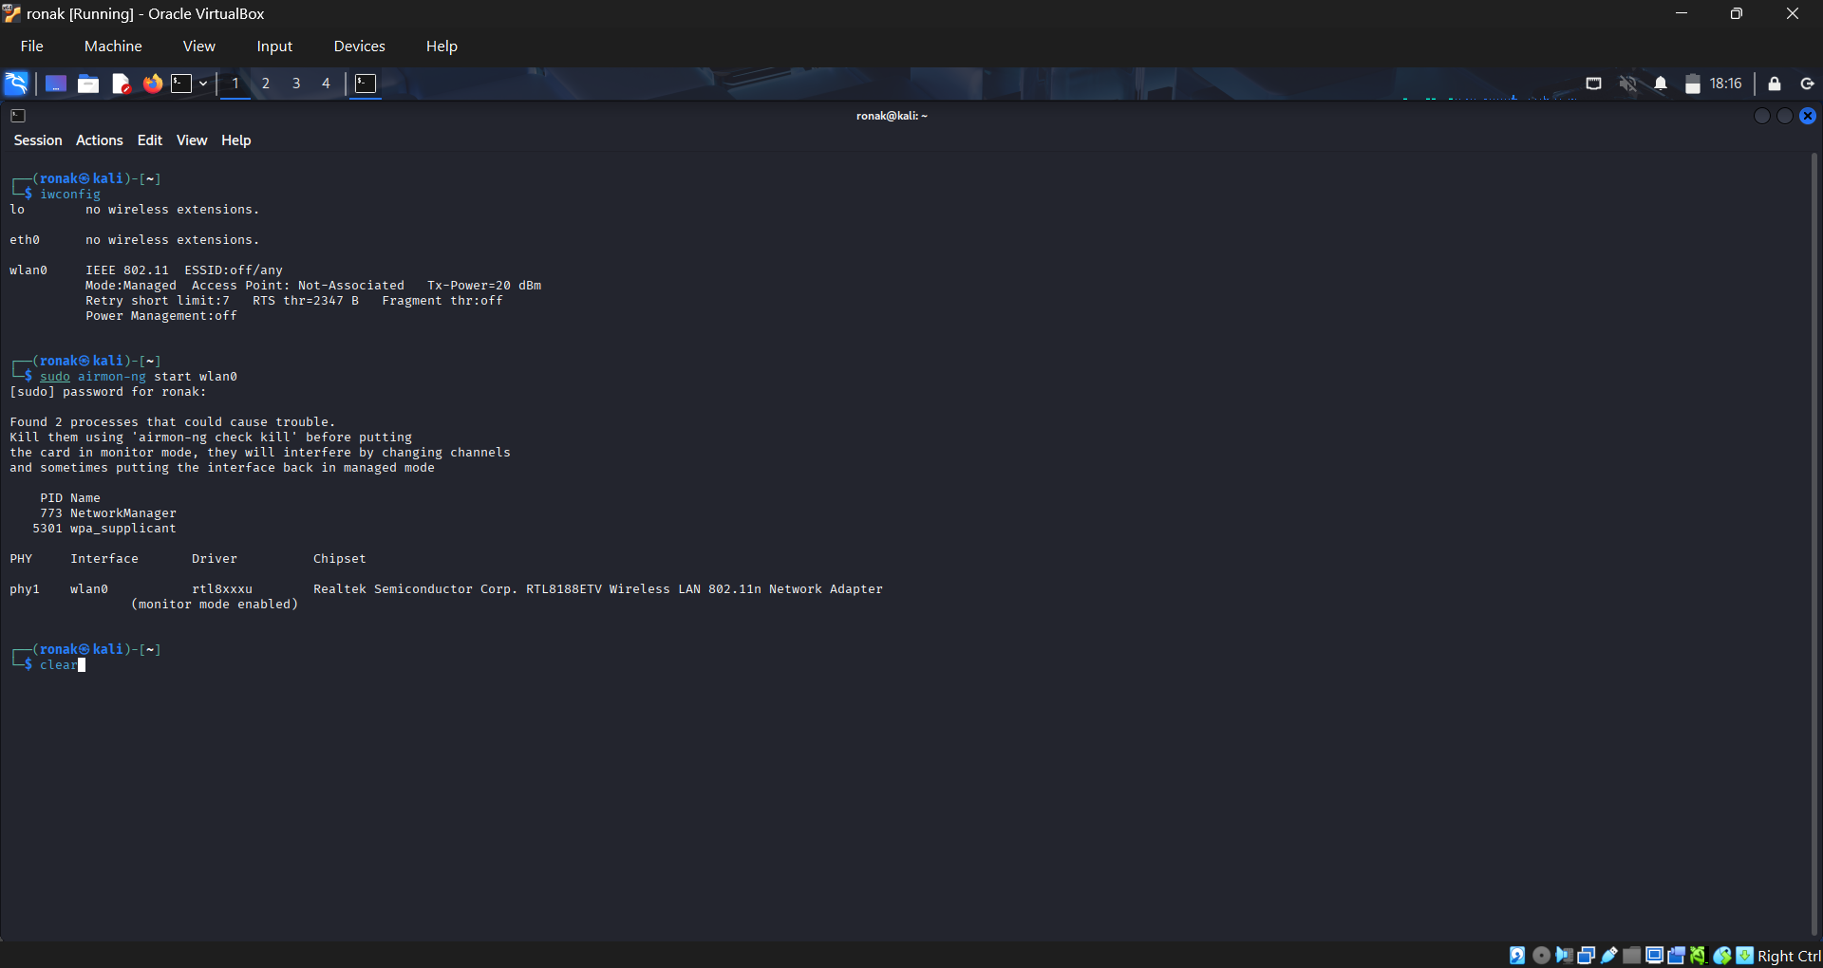

Slide 15


Press Enter

Slide 16
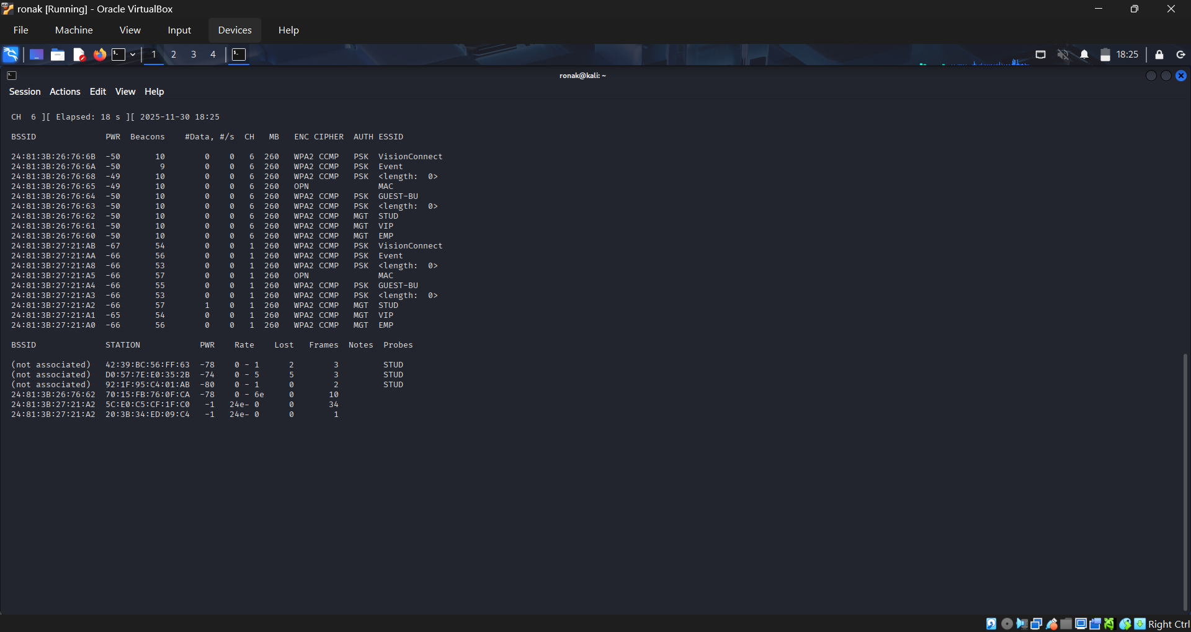

Tap session and click new tab

Slide 17
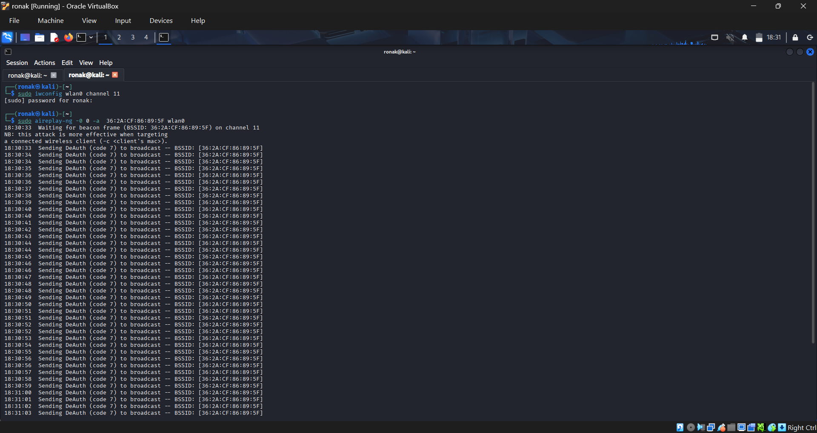

fFor stop :- ctrl+z

Slide 18
USB Wi-Fi Adapters for Security Research
What is a USB Adapter?
Recommended Chipsets
A USB Wi-Fi adapter is an external network interface that plugs into your computer's USB port. Unlike built-in Wi-Fi cards, many USB adapters support monitor mode and packet injection—essential for security research.
Atheros AR9271
Excellent Linux support, reliable for most tasks
Why Use One?
Ralink RT3070
Built-in cards often lack advanced capabilities
Good compatibility, budget-friendly option
Can be passed through to virtual machines
Supports specialized security tools
Allows channel hopping and raw packet capture
Realtek RTL8812AU
Dual-band support (2.4 & 5 GHz), powerful
Popular Models: Alfa AWUS036NHA, TP-Link TL-WN722N v1, Panda PAU09
Always verify chipset compatibility with Kali Linux before purchasing. Check the Kali documentation for the most current list of supported hardware.
Notes:
9

Slide 19




Legal Tools for Wi-Fi Security Research
These professional tools are used by security researchers, network administrators, and IT professionals for legitimate monitoring, analysis, and authorized testing only.
Wireshark
Aircrack-ng Suite
Industry-standard packet analyzer for capturing and examining network traffic. Essential for understanding protocol behavior and identifying anomalies.
Comprehensive toolkit for wireless network assessment, including monitoring, packet capture, and security testing of your own networks.
Kismet
Nmap
Wireless network detector and analyzer that passively monitors traffic without sending packets. Useful for network inventory and rogue AP detection.
Network scanning tool for discovering devices, open ports, and services. Helps identify security weaknesses in your own infrastructure.
Critical Reminder: These tools must only be used on networks you own or have explicit written permission to test. Unauthorized use violates federal and state laws, institutional policies, and ethical standards. Always operate in isolated lab environments for educational purposes.
Notes:
10

Slide 20
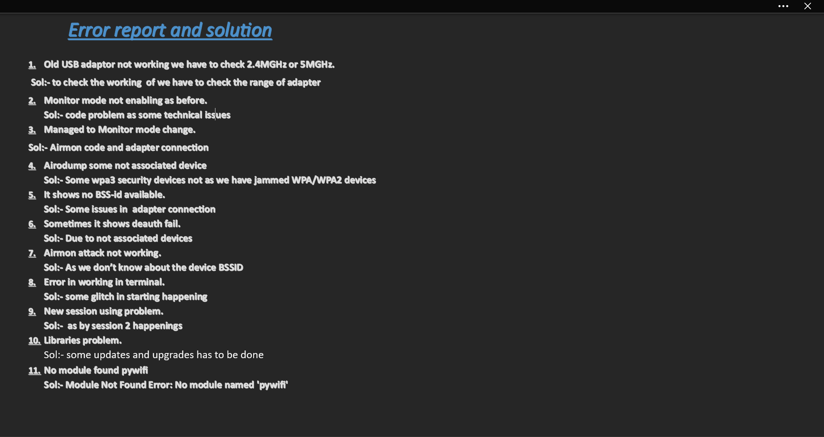

Slide 21

jbed
Shivang Mahawar
Ronak Sharma
Bhavishya
Priyanshu Kumar
Shaurya Sharma
Thank-You

